Slide 1
Terminal App -- Rubylist
Jacin Yan

Slide 2
What is Rubylist?
An interactive application to help users organise tasks and plans
Easy to use without fail
Should be helpful to non-English native students and developers
Simple but not created in a simple way

Slide 3
Components
To-do list based structure to facilitate active learning
Feedback quiz to help improve functionality
Features :
1. multiple list creation
2. basic CRUD for single lists
3.local storage
4.(online dictionary and cloud drive)

Slide 4
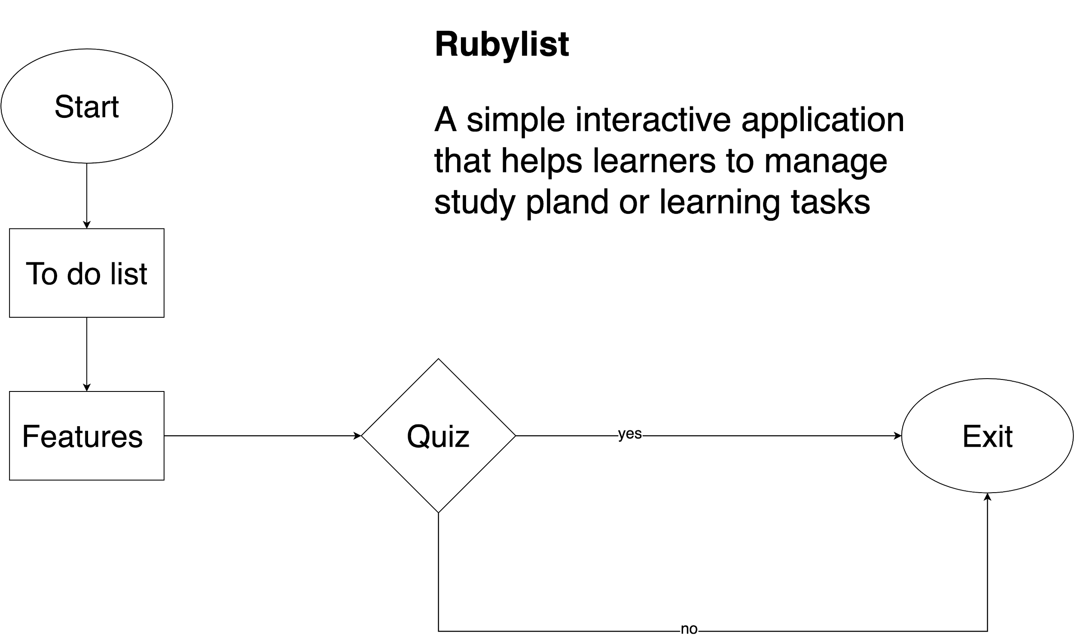
Flowchart

Slide 5
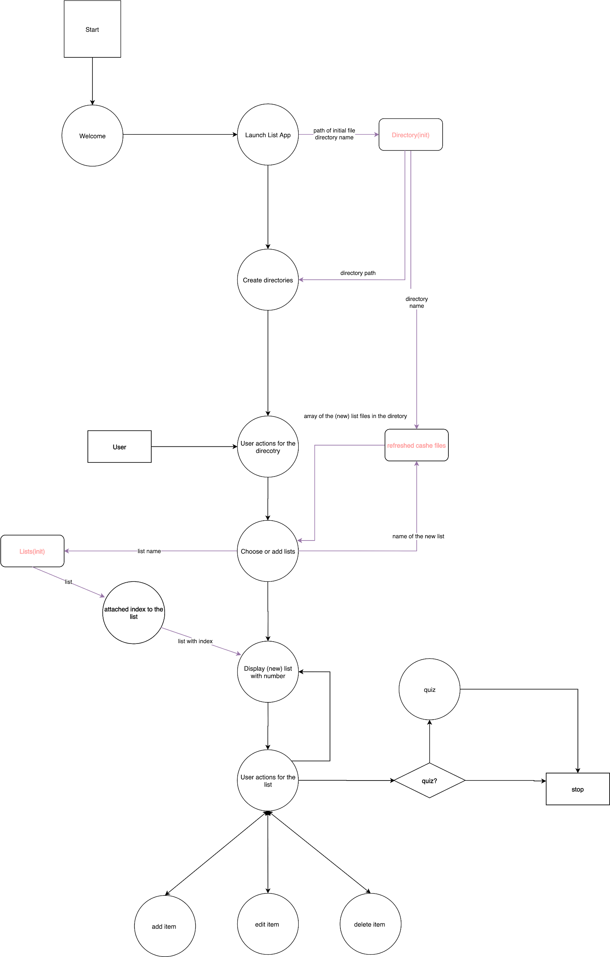
Data-flow Diagram

Slide 6
Challenges
Challenges everywhere
Lack of knowledge about file handling
Confusion about data flow
No experience in debugging tools, e.g. Rspec, built-in Ruby Debugger or its VS extension
Low level of proficiency in Ruby itself

Slide 7
Favourite parts
The process of piecing every bit that was brand new to me together is invaluable
In short, they are all my favs!

Slide 8
Thank you

